Slide 1
Sales Performance Analysis of Walmart Stores Using Advanced MySQL Techniques
Name : Gazi Aman Khan
Course : data science (15th may)

Slide 2
Dataset Introduction and Aim
Walmart Sales Dataset – Overview
Size: 1,000 transaction records with 18 columns.
Branches & Cities: 3 branches (A, B, C) located in Yangon, Mandalay, and Naypyitaw.
Customer Information: Includes Customer type (Member/Normal), Gender, and unique Customer ID.
Sales Details: Product category (Product line), Unit price, Quantity, cogs, gross income, Total, and Tax 5%.
Transaction Details: Invoice ID, Date, Time, and Payment method (Cash, Ewallet, Credit Card).
Feedback: Customer Rating (1–10 scale).
AIM : To use advanced SQL to analyze sales performance, customer behavior,
and product trends.

Slide 3
Business Problem
Walmart wants to optimize its sales strategies by analyzing historical transaction data across branches, customer types, payment methods, and product lines. To achieve this, advanced MySQL queries will be employed to answer challenging business questions related to sales performance, customer segmentation, and product trends.
Key goals: analyze sales growth, customer segmentation, product trends, payment behavior, repeat customers, etc.

Slide 4
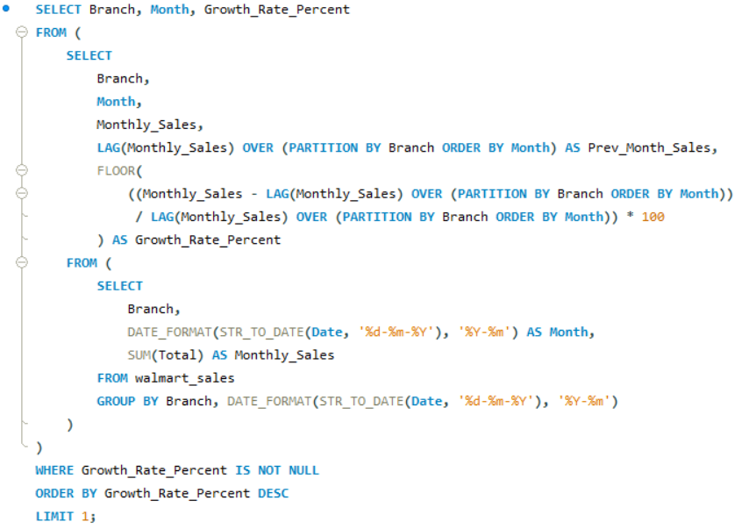

Task 1: Identifying the Top Branch by Sales Growth Rate
Result Table :

Slide 5
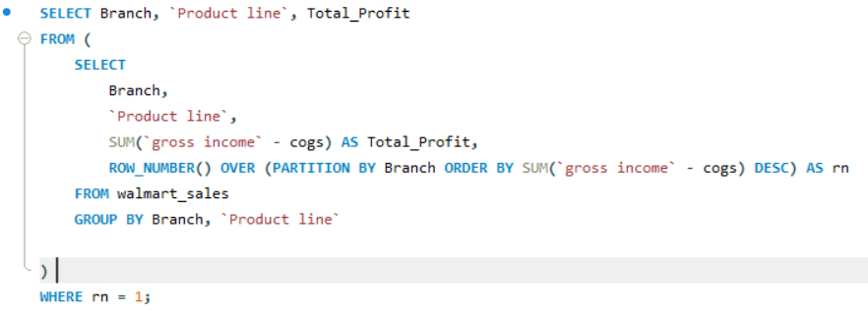

Task 2: Finding the Most Profitable Product Line for Each Branch
Result Table:

Slide 6
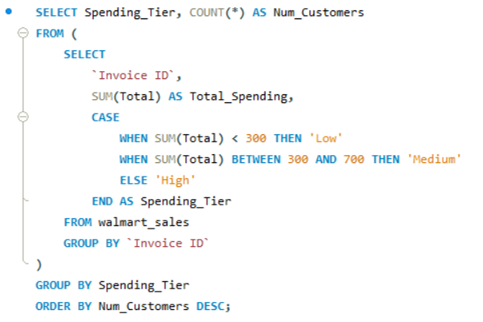

Task 3: Analyzing Customer Segmentation Based on Spending
Result Table:

Slide 7
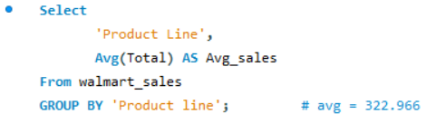
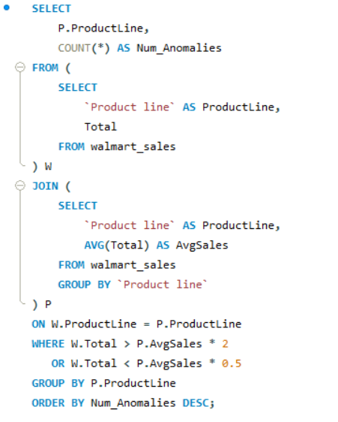
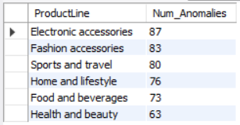
Task 4: Detecting Anomalies in Sales Transactions
Result Table:

Slide 8
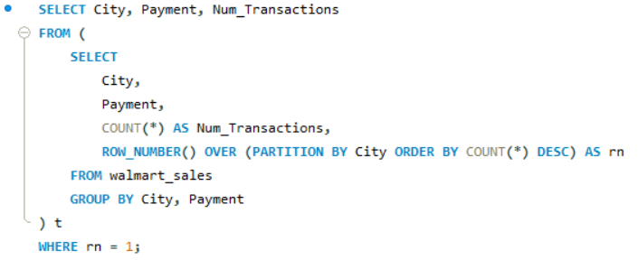

Task 5: Most Popular Payment Method by City
Result Table:

Slide 9
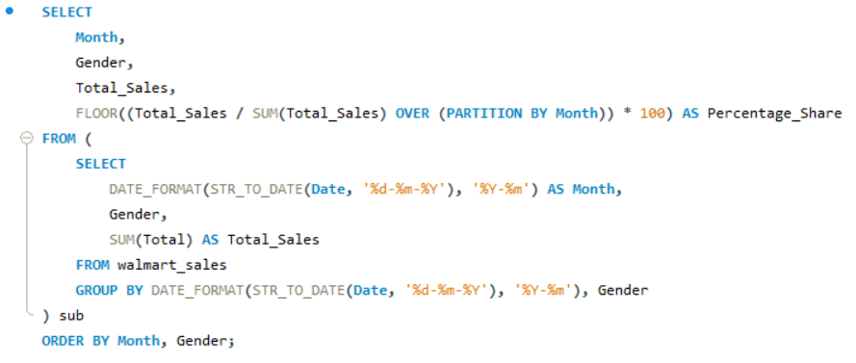
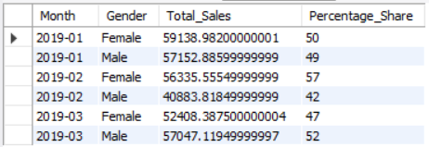
Task 6: Monthly Sales Distribution by Gender
Result Table:

Slide 10
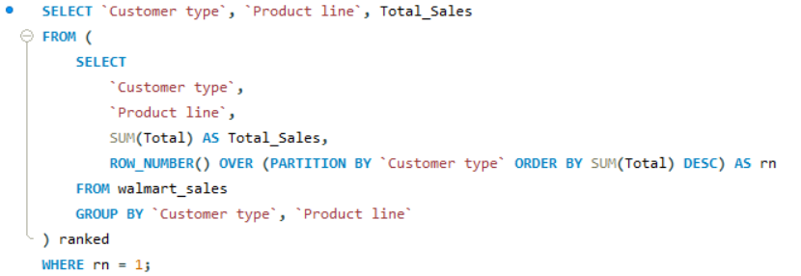

Task 7: Best Product Line by Customer Type
Result Table:

Slide 11
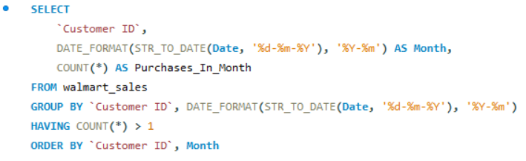
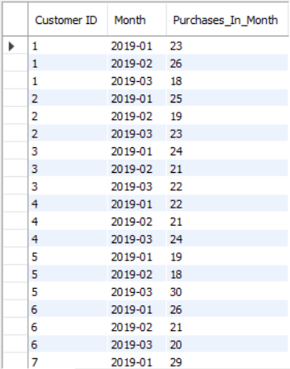
Task 8: Identifying Repeat Customers
Result Table:

Slide 12
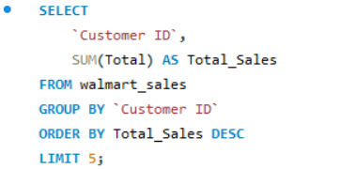
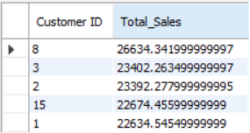
Task 9: Finding Top 5 Customers by Sales Volume
Result Table:

Slide 13
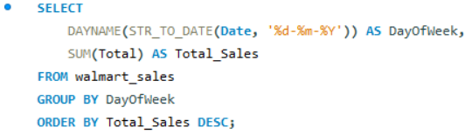
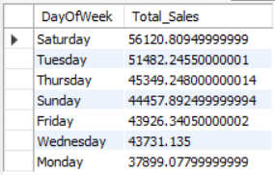
Task 10: Analyzing Sales Trends by Day of the Week
Result Table:

Slide 14
Explanation video link :https://www.loom.com/share/a7a7ebe4aaa3439f96e82fa8aeef2421?sid=72244584-6bcd-426a-b8f5-1a0ec3e0cb70

